Slide 1
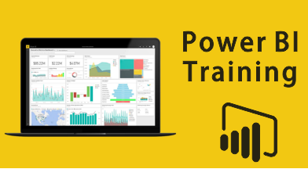

Slide 2
Introduction
Power BI is business intelligence (BI) and analytics tool created for the purposes of helping businesses/people to see, understand, and make decisions with data.
PBI is a Data Visualization tool which helps you to convert data from various data sources
It engages with their data, ask questions, solve problems and create value.
It provides interactive visualizations and business intelligence capabilities with an interface simple enough for end users to create their own reports and dashboards.
Excel (.xlsx, xlxm), Comma Separated Value (.csv), Power BI Desktop (.pbi), Databases in the Cloud, Databases on-premises are important data sources used in Power BI.
What is BI?
Business intelligence is a technology-driven method which helps you to analyze data and to provide actionable information which helps corporate executives, business managers, and other users to make business decisions. It also helps keep track of business data and draw valuable insights.

Slide 3
Why Power BI?
Power BI has the ability to access vast volumes of data from multiple sources.
It allows you to view, analyze and visualize huge quantities of data that cannot be opened in excel.
Some of the important data sources available in PBI are Excel, CSV, XML, PDF, SQL, Oracle etc.
Power BI provides an easy-to-use, drag-and-drop tool with features and functionalities that allows you to copy all formatting across similar visualizations.
PBI has exceptional integration with excel. It helps you gather, analyze, publish and share excel business data.
PBI helps to accelerate big data preparation with Azure.
With Azure data, you can reduce the time it takes to get insights and increase collaboration between business analysts, data engineers and data scientists.
PBI allows you to get insights from data and turns insights into actions to take data-driven business decisions.
PBI fetches data from factory sensors and social media sources to get access to real-time analytics so you are always ready to make timely business decisions.

Slide 4






Components of Power BI
Power Query – Clean the data/Data transformation & Mash-up Engine
Power Pivot - Data Modeling & Calculation Engine
Power View - Visualization data
Power Map - Visualize geospatial data in 3D mode
SharePoint – Delivery, Collaboration
Power Q&A - A Natural Language engine for Q&A to your data model

Slide 5
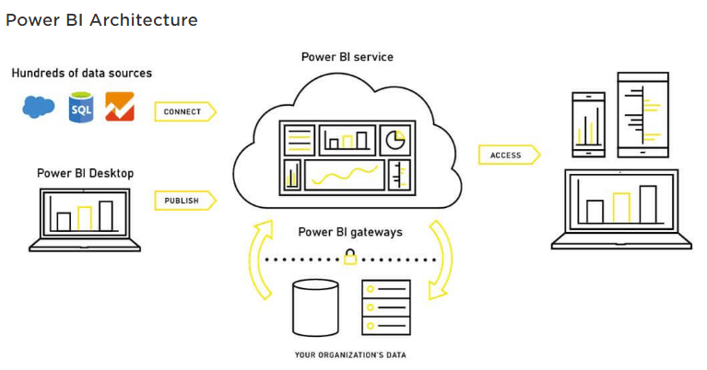
Power BI Architecture
Data Integration: An organization needs to work with data which comes from different sources which can be in various file formats. This data is integrated into one standard format in a common staging area. Data Processing: In this stage, the integrated data is still not prepared for visualization as the data needs processing. This data is pre-processed. For example, redundant values, missing values will be removed from the data set. The business rule should be applied to the data when the data is cleaned. You can load that data back to Data Warehouse. Data Presentation: Once the data is loaded and processed, it can be visualized much better with use of various visualization that Power Bi has to offer. This visual report helps business end users to take business decision based on the insights.

Slide 6
Data Types
Two main data types that you will always encounter are
Dimension / Categorical Data
Numerical / Fact Data
Dimension data – Non Numerical data. Examples are name, gender, eye color or continents etc.
Numerical data can be continuously measured. Some common examples of numerical data include temperature or height, age, sales etc.

Slide 7
Topics
Introduction
Report View/Data View/Modelling View
Filter/Visualization/Fields Pane
Options on Ribbon
Different Visuals on PBI
Relationships – 4 Types
One to One
One to Many
Many to One
Many to Many
Joins
Query Editor and Options in it
ToolTip
Interactives Filters
Hierarchy
Drill up/Down
Drill Through
Append Tables
Merge Table
Conditional Column
Conditional Formatting
DAX - Measures/Columns
Bookmarks
Parameters
Dashboard building
Publish
Natural Language Processing

Slide 8


Columns Vs Measures
COLUMNS
Used for Row by row calculations like excel
Pre-calculated and stored
Not recalculated (not dynamic) when filter changes on the dashboard
Only recalculates on the data source refresh
Calculated Columns return one value per row
Take up space in RAM memory
Try avoiding calculated columns if we don’t need them
Acts like a “Normal” column. Can be used in calculations and relationship
MEASURES
Used for calculations across Row
Not stored in RAM
Calculated on the fly & recalculated when the filters applied changes
Returns different answers depending on the filter applied
Takes up CPU Space
Can be reused on other measures
Can be moved between tables
Cannot be used for relationships
It returns only one single value (aggregate)
We use aggregations for measures as we want to end up with one single value (ex: sum, min, max, count, avg…)
Cannot see the measure in the Data tab/view as it evaluates/calculates only when it is put in the report and are calculated on fly.
Measures vs. calculated columns in DAX and Power BI - YouTube

